Slide 1
RaspiGuard
By Vivek Socrates, Karel Tutsu, & Heakeme Williams

Slide 2

Purpose
Low cost monitoring system
Easy to use and setup
Monitor light, door and moisture of plants
Access data from phone, website, and hardware

Slide 3
Budget
Component |  | Cost
Raspberry Pi Model B |  | $39.95
adafruit PiTFT Plus 480x320 3.5" |  | $44.95
Raspberry Pi Power Adapter |  | $16.95
adafruit ADS1115 |  | $14.95
ADATA Premier 8GB microSDHC UHS-I Class 10 |  | $8.99
ADATA microReader Ver.3 microSDHC |  | $4.99
SparkFun Soil Moisture Sensor |  | $5.95
Photo Cell (CdS Photoresistor) |  | $0.95
Magnetic Contact Switchs |  | $3.95
Raspbian (OS) |  | $0.00
2x13 Female Header |  | $0.95
10K Resistor |  | $0.25
SUBTOTAL | $142.83
TAX | $18.57
TOTAL | $161.40

Slide 4
Schedule

Slide 5
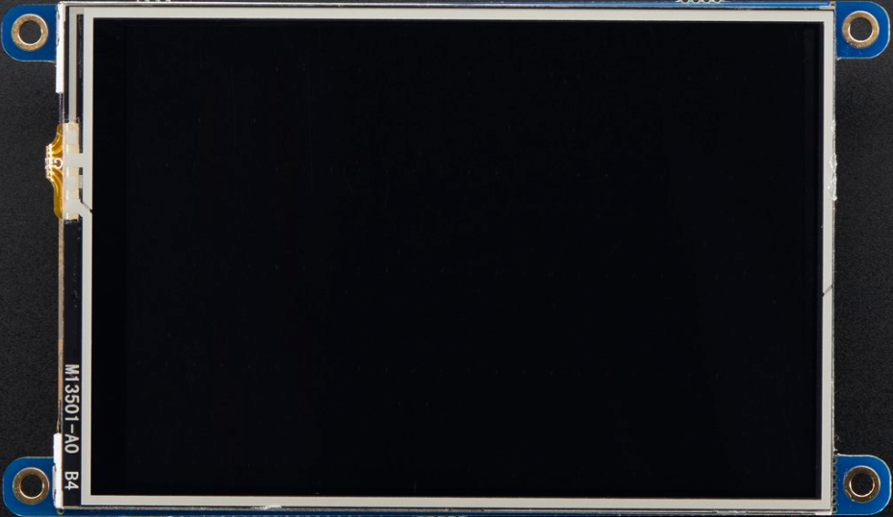
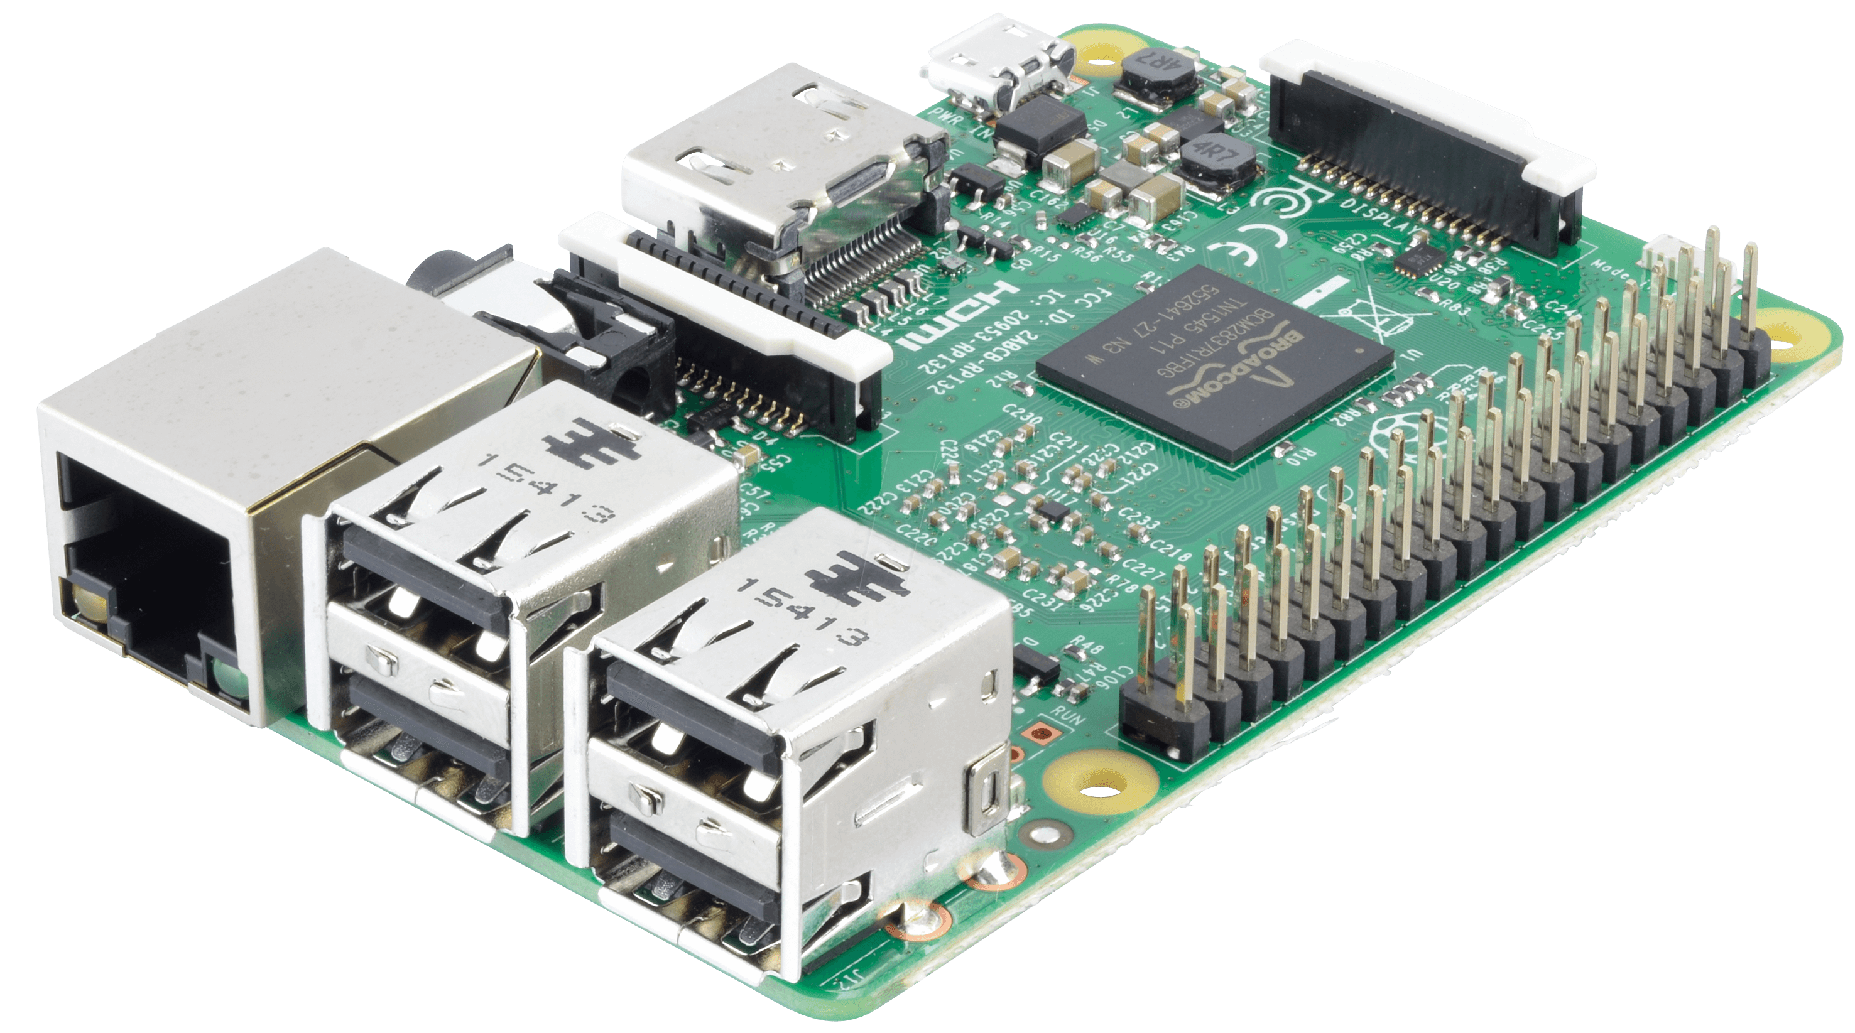
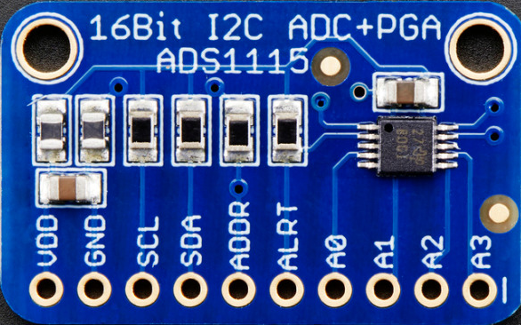
Hardware

Slide 6
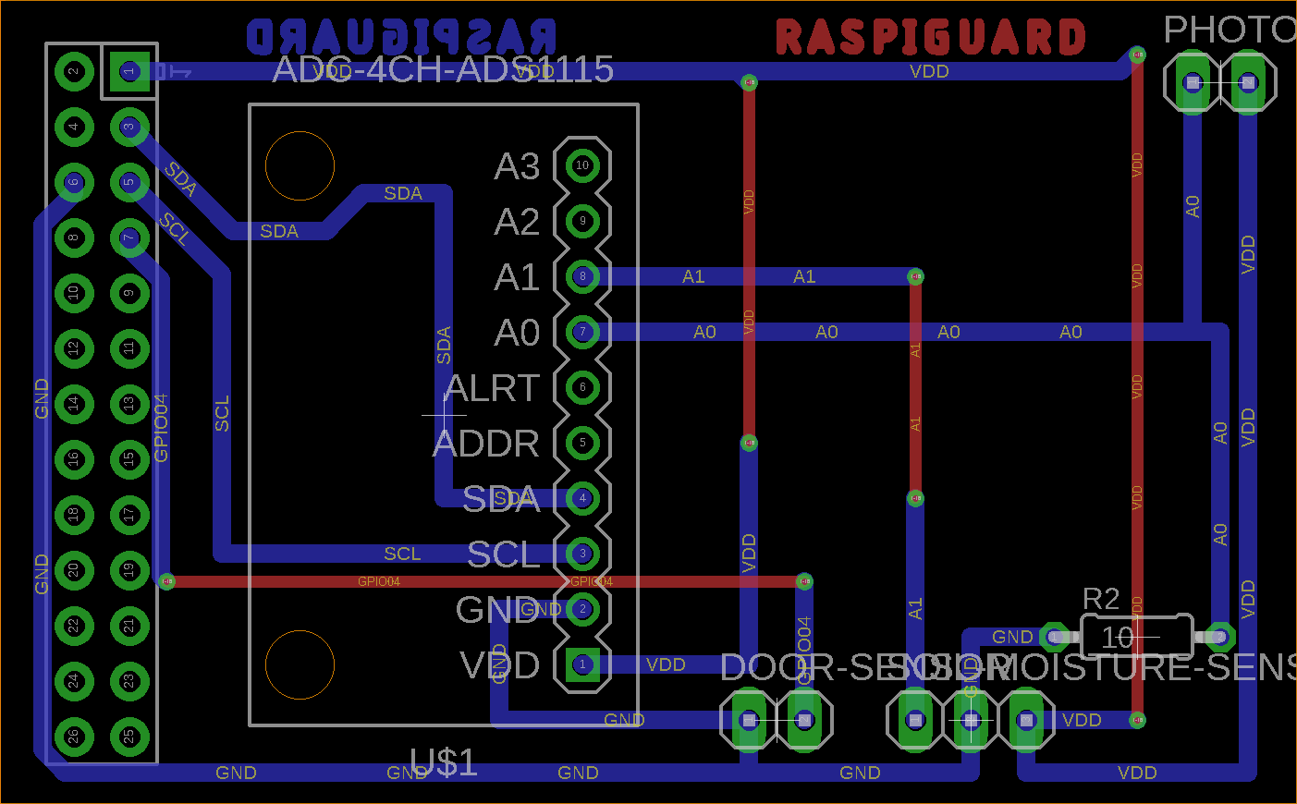
PCB

Slide 7



Software

Slide 8

Skills & Knowledge
Hardware:
Curcuit building
Soldering
PCB Design
Software:
Java, Python, SQL
Web design, Android Programming
Linux (Raspbian)
All knowledge acquired from Computer Engineering Technology program and independent research

Slide 9
Recommendations
Expand / Shrink RaspiGuard by changing Raspberry Pi and PiTFT model

